Slide 1
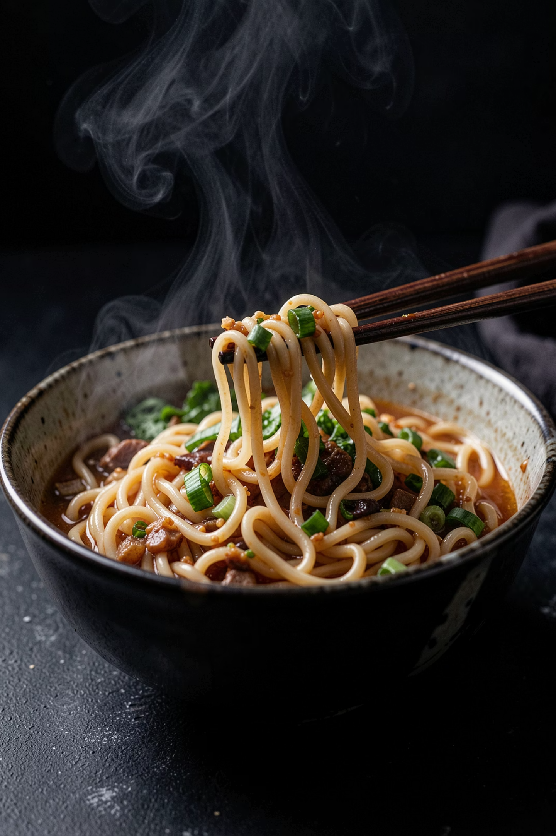
Noodle House
Facebook Marketing Strategy
Bringing authentic, quick, and delicious noodles to the hearts and feeds of urban India.
Speaker Notes: "Welcome everyone. Today, Rohit and I are thrilled to present our Facebook Marketing Strategy for Noodle House. Our goal is to transform our passion for authentic, quick-service noodles into a highly engaging digital brand that drives foot traffic and online orders."

Slide 2
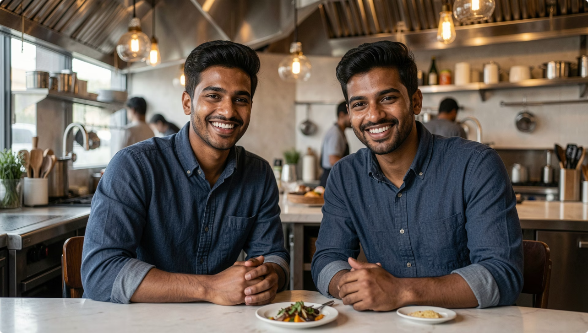
OUR STORY
Meet Noodle House
Founded by Karan and Rohit, Noodle House is born out of a pure passion for authentic, quick-service street-style noodles. We are redefining the QSR model for India's fast-paced urban dwellers.
Quick Service Excellence
Uncompromised Quality
Hot, fresh, and customizable noodle bowls served in under five minutes.
Using daily-prepped fresh vegetables, signature handmade sauces, and premium ingredients.
Speaker Notes: "Noodle House was founded because Rohit and I couldn't find quick, high-quality, authentic noodles during our busy workdays. We've designed a Quick Service Restaurant model that serves fresh, customizable, and steaming hot noodle bowls in minutes without compromising on flavor."

Slide 3

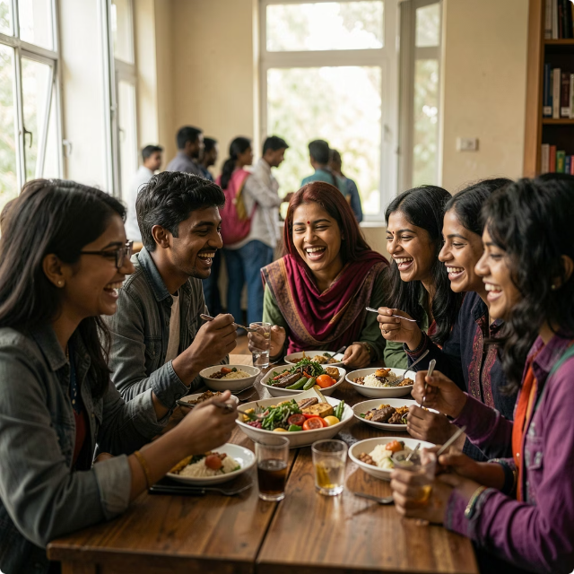
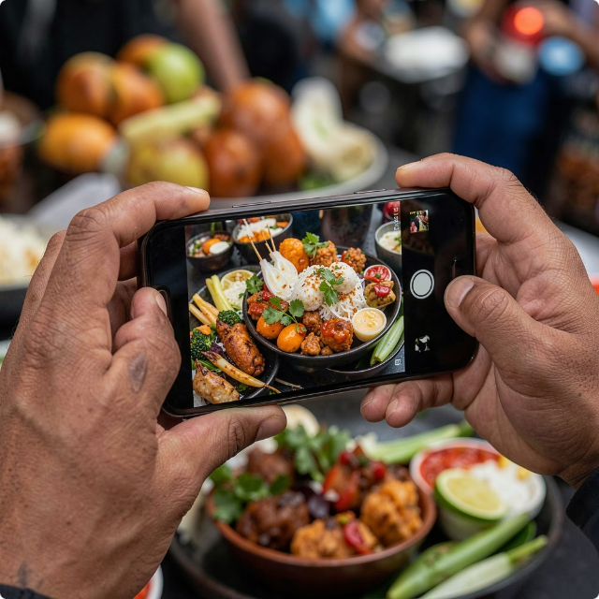
Our Target Audience on Facebook
We focus our marketing efforts on high-intent urban demographics who value flavor, speed, and culinary exploration.
Young Professionals
Students & Families
Food Explorers
Aged 22-35, looking for quick, high-quality, and delicious lunch or dinner options during hectic workdays.
Budget-conscious food lovers seeking generous portions, exciting menu options, and convenient dining.
Passionate foodies actively searching local culinary hubs, chasing trends, and sharing their discoveries online.
Speaker Notes: "Our Facebook targeting is highly specific. Our primary audience consists of young professionals who want a fast but premium meal. We also target local students and families who seek value, alongside active food explorers who love sharing their food journeys online."

Slide 4
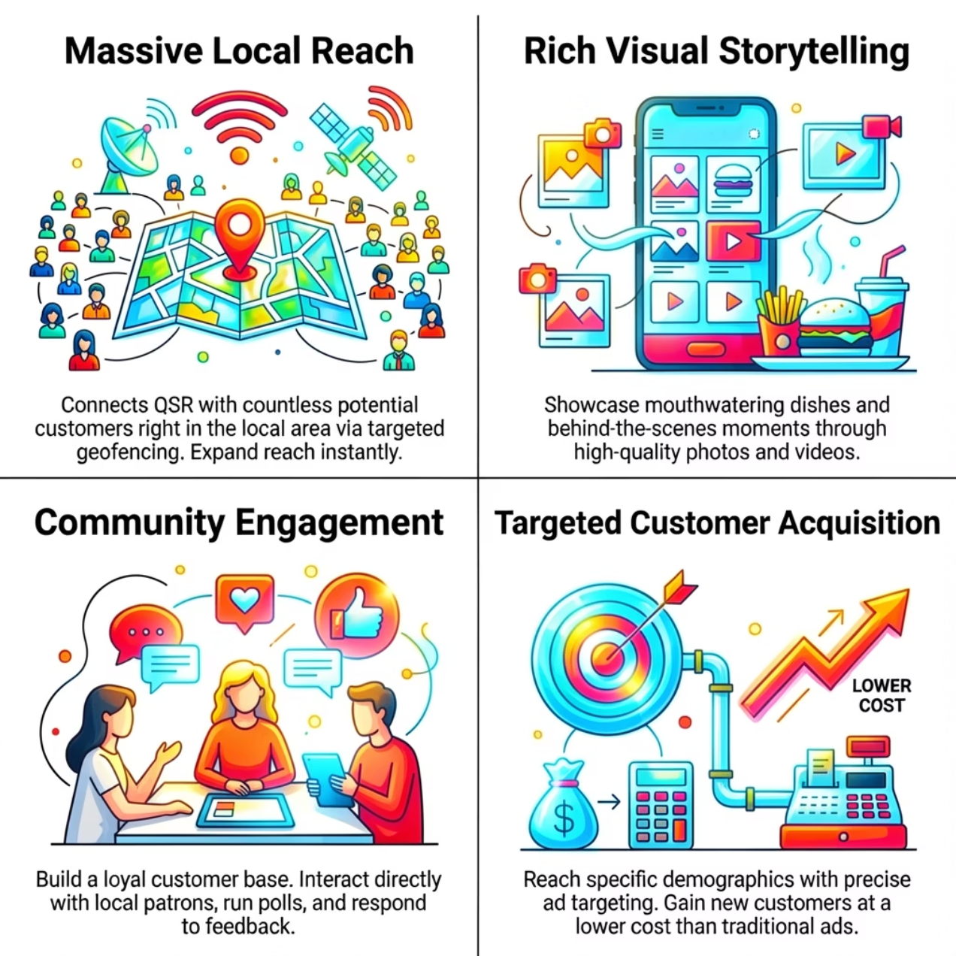

THE PLATFORM
Why Facebook Matters
Facebook remains India's most powerful social platform for local business discovery and highly targeted customer acquisition.
Hyper-Local Reach: Target hungry customers within a precise 3-5 km radius of our outlets.
Visual Storytelling: Captivate audiences with high-definition cooking videos and food close-ups.
Direct Social Commerce: Turn scrolls into sales through 'Order Now' integrations and localized ads.
Speaker Notes: "With its massive user base in India, Facebook is the perfect tool for Noodle House. It allows us to combine rich visual storytelling with hyper-local ads that target users who are physically close to our locations right around lunchtime."
Notes:
This is important.

Slide 5

Content Pillar 1: The Food Experience
We put our food front and center. Sensory-rich content designed to stimulate cravings and build visual consistency across our feed.
High-Quality Food Visuals
Behind-the-Scenes Action
Dish of the Week
Stunning macro photography of glistening sauces, vibrant veggies, and steaming hot noodles to stop the scroll.
High-energy short videos showcasing roaring woks, fresh ingredient prep, and our chefs in action.
Weekly deep-dives into specific menu items, highlighting unique spices, noodle textures, and ideal pairings.
Speaker Notes: "Our first content pillar is all about food cravings. We will post high-definition close-ups of our dishes, high-energy videos of our chefs working the woks, and run a 'Dish of the Week' series to educate customers about our diverse menu."

Slide 6
Content Pillar 2: The Noodle House Story
People buy from people. We will humanize our brand by sharing our entrepreneurial journey and celebrating our local community.
Karan & Rohit's Journey
Meet the Team
Customer Testimonials
Authentic posts detailing how two best friends went from cooking in a home kitchen to launching Noodle House.
Regular features on our kitchen staff, servers, and delivery partners who bring the magic to life daily.
Sharing real user-generated content, positive reviews, and screenshots of happy messages from our fans.
Speaker Notes: "Our second pillar focuses on authenticity. Rohit and I want to share our startup story directly. We'll also feature our incredible staff and share real, unedited reviews from our customers to build genuine trust and credibility."

Slide 7
Content Pillar 3: Engagement & Offers
Creating two-way conversations to build an active, loyal community of noodle lovers on our page.
Interactive Content
Contests & Giveaways
Exclusive Facebook Deals
Hosting weekly polls like 'Spicy vs. Mild' or 'Wheat vs. Rice Noodles' to boost organic reach and drive daily audience interaction.
Viral campaigns encouraging followers to tag friends, share our posts, or upload their own noodle photos to win free meals.
Time-sensitive discount codes and special weekend combo offers tailored exclusively for our active Facebook followers.
Speaker Notes: "To keep our page lively, our third pillar focuses on interactive engagement. We'll run weekly polls to understand customer preferences, execute viral 'tag-a-friend' contests, and offer exclusive discount codes to reward our loyal online community."

Slide 8

Targeted Advertising Strategy
Hyper-Local Awareness
Lookalike Expansion
Interest Targeting
Our advertising setup moves prospects smoothly from initial brand discovery to repeat, loyal orders.
Speaker Notes: "We aren't just boosting posts randomly. We've built a structured ad funnel. We'll start with hyper-local awareness ads around our shops, layer in interest-based targeting for foodies, expand using lookalike audiences, and run retargeting ads to win back past visitors."

Slide 9



Key Performance Indicators (KPIs)
We measure success through clear commercial and digital metrics to ensure our marketing drives positive business results.
Reach & Awareness
Audience Engagement
Conversion Rate
Tracking overall monthly impressions and unique users reached in our target zip codes.
Measuring organic interactions, including likes, comments, shares, and saves per post.
Monitoring 'Order Now' button clicks, website traffic, and physical coupon redemptions at our stores.
Speaker Notes: "We want to ensure every rupee spent on Facebook delivers value. We will closely monitor local reach, watch our engagement rates to ensure our content resonates, and track direct conversions through online order clicks and in-store coupon redemptions."

Slide 10

Deliciousness Delivered
Next Execution Steps
Content Calendar: Finalise the first 30 days of rich visual posts.
Ad Setup: Launch our first hyper-local reach campaigns next week.
Community Management: Dedicate time daily to reply to every comment and message.
Our ultimate vision is to become the most loved quick-service noodle destination in India, one plate at a time.
Join the Family: Follow Noodle House on Facebook today for daily culinary inspiration and exclusive deals.
Speaker Notes: "In conclusion, Rohit and I are ready to scale Noodle House into a beloved household name. By executing this consistent, highly-targeted Facebook strategy, we will build a passionate community of food lovers. Let's get the woks firing!"

